Slide 1
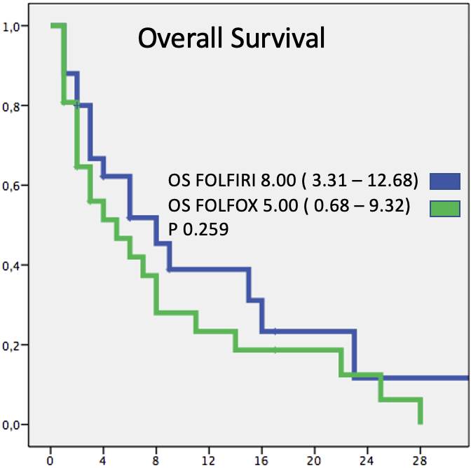
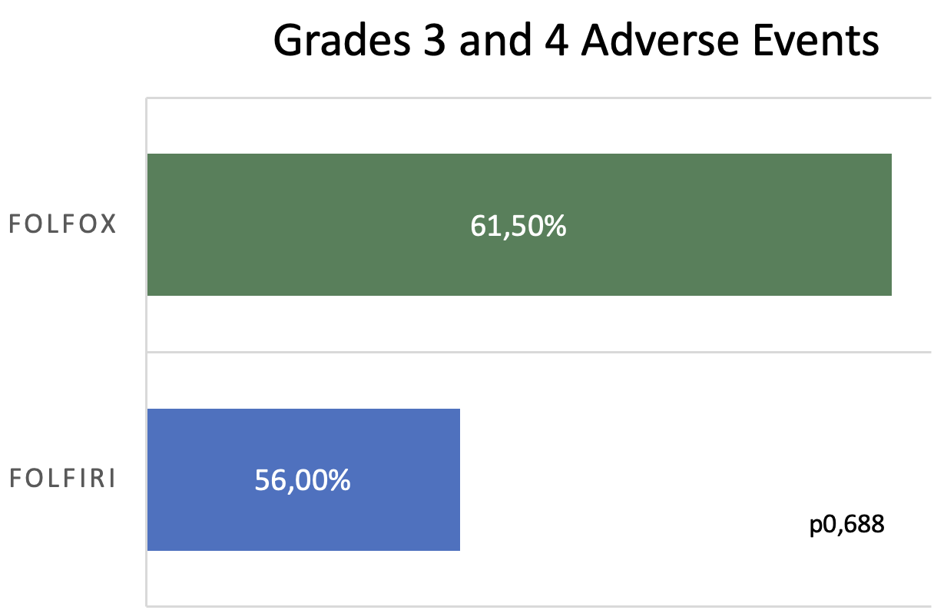
Encontro de Ciência e Inovação 2023
Folfiri or Folfox in second line advanced of biliary tract cancer, a retrospective analysis
M. BALARINE¹, M. CAMANDAROBA¹ and T. FELISMINO¹
INTRODUCTION
Single-center retrospective study of metastatic or irresectable cholangiocarcinoma treated in second-line treatment with FOLFIRI or FOLFOX.
The primary endpoint was OS and secondary endpoints included PFS and toxicity analysis.
OS time was analyzed using the Kaplan-Meier method. Differences in survival outcomes were assessed using the log-rank test.
The median follow up time was 45.5 months, and the unadjusted median OS was 8 months (95% confidence interval [CI] 3.31 – 12.68) in FOLFIRI group vs 5 months (95% CI 0.68 – 9.32; p= 0.259) in FOLFOX group.
In Cox's analysis for OS the platinum-resistant/refractory chemotherapy had a worse outcome with Hazard Ratio 2.58 (IC 95% 1.35 – 4.92) p= 0.004.
Cholangiocarcinoma is a rare malignancy, globally accounting for 3% of upper gastrointestinal cancer.
Despite recent advances in first-line treatment leading to gains in progression-free survival (PFS) and overall survival (OS) with the association of immunotherapy, further lines of treatment are yet underrepresented in large randomized clinical trials.
Prior to 2018, there was no standard treatment in second-line, which was often a 5-FU-based doublet in combination whether with Irinotecan (FOLFIRI) or Oxaliplatin (FOLFOX).
The most robust data comes from a phase 3 randomized trial ABC06, which has established FOLFOX versus active symptom control as the best treatment option.
RESULTS
In all, 103 patients who received Cisplatin and Gemcitabine were included in the study database. Among these, 25 (29.9%) received FOLFIRI and 26 (38.8%) received FOLFOX in second-line treatment after disease progression. The median of treatment cycles was 5 (Interquartile Range [IQR] 2 – 8) in FOLFOX group and 4 (IQR 2 – 9) in FOLFIRI group. Grades 3 and 4 adverse events were no different between the group FOLFOX (n= 16; 61.5%) versus (vs) FOLFIRI (n=14; 56%, p= 0.688).
Aim AND METHODS
conclusions
Retrospectively compare the efficacy and impact on survival and quality of life of patients diagnosed with metastatic bile duct cancer treated with either the FOLFOX or FOLFIRI chemotherapy regimen in the second line at AC Camargo Cancer Center between 2010 and 2019, after they received Cisplatin and Gemcitabine in first line treatment.
Recognizing the limitations of a single-center retrospective study, the study provides evidence that the FOLFIRI regimen may be a safe option for the second-line treatment of metastatic cholangiocarcinoma.
Khan, S. A., Tavolari, S., & Brandi, G. (2019). Cholangiocarcinoma: Epidemiology and risk factors. Liver International, 39(S1), 19–31. https://doi.org/10.1111/liv.14095
Oh, D.-Y., He, A. R., Qin, S., Chen, L.-T., Okusaka, T., Vogel, A., Kim, J. W., Suksombooncharoen, T., Lee, M. A., Kitano, M., Burris III, H. A., Bouattour, M., Tanasanvimon, S., Zaucha, R., Avallone, A., Cundom, J., Rokutanda, N., Xiong, J., Cohen, G., & Valle, J. W. (2022). A phase 3 randomized, double-blind, placebo-controlled study of durvalumab in combination with gemcitabine plus cisplatin (GemCis) in patients (pts) with advanced biliary tract cancer (BTC): TOPAZ-1. Journal of Clinical Oncology, 40(4_suppl), 378–378. https://doi.org/10.1200/JCO.2022.40.4_suppl.378
Valle, J., Wasan, H., Palmer, D. H., Cunningham, D., Anthoney, A., Maraveyas, A., Madhusudan, S., Iveson, T., Hughes, S., Pereira, S. P., Roughton, M., & Bridgewater, J. (2010). Cisplatin plus Gemcitabine versus Gemcitabine for Biliary Tract Cancer. New England Journal of Medicine, 362(14), 1273–1281. https://doi.org/10.1056/NEJMoa0908721
Lamarca, A., Palmer, D. H., Wasan, H. S., Ross, P. J., Ma, Y. T., Arora, A., Falk, S., Gillmore, R., Wadsley, J., Patel, K., Anthoney, A., Maraveyas, A., Iveson, T., Waters, J. S., Hobbs, C., Barber, S., Ryder, W. D., Ramage, J., Davies, L. M., … Valle, J. W. (2021). Second-line FOLFOX chemotherapy versus active symptom control for advanced biliary tract cancer (ABC-06): a phase 3, open-label, randomised, controlled trial. The Lancet Oncology, 22(5), 690–701. https://doi.org/10.1016/S1470-2045(21)00027-9

