Slide 1
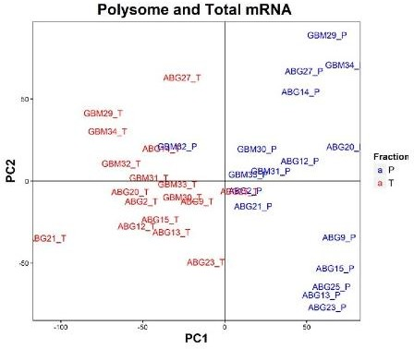
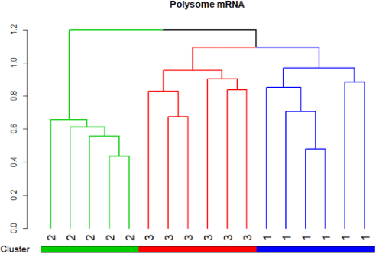
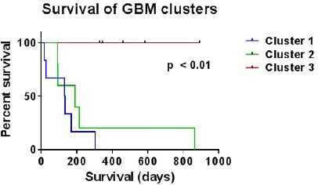
A NEW TARGET SIGNATURE FOR GLIOBLASTOMA BASED ON TRANSLATOMIC ANALYSIS
Elias B.D.S**., Lupinacci F.C.S., Larsson O., Hajj G.N.M.
Encontro de Ciência e Inovação
2023
BACKGROUND
RESULTS AND CONCLUSIONS
Glioblastoma (GBM) is among the most aggressive and least responsive tumor types to therapies. At present, data on gene expression in these tumors is based on the total mRNA expression, however, this approach provides little information about the cellular proteome. In view of this, the population of mRNAs that are actively being translated (polysome associated mRNA) more faithfully reflects protein expression and is thus closer to the true measurement of gene expression. Our aim was to investigate gene expression profiles and establish molecular groups with relevant biological signatures from polysome associated mRNAs from 47 GBM samples patients (Research Ethics Committee 1775/13 and 1692/12).
Figure 2. Poly-mRNA data revealed a separation of the data into three groups with impact on survival (1, 2 and 3). Clusters generated by the unsupervised analysis of the polysomal RNA data. The clusters are indicated by colors, according to the separation by PCA and survival relative to the clusters generated in the polysomal RNA analysis.
GSEA analysis reveal differentially expressed genes (FDR<0.01) to each group include: SPRY4, PDGFD, DUSP14, eIF6, RPUSD3 and MRPS18A, increased in cluster MIT (cluster 1); ARHGEF11, AGO2, SIPA1, STK11, VEGFA and NOTCH3, increased in cluster ANG (cluster 2); and DHX9, SMARCA5, SRPK2, KIAA1429, METTL14 and PCM1, increased in cluster RNA (cluster 3).
Our work a new molecular signature for GBMs, with potential to increase our knowledge of the disease and suggest new therapeutic approaches.
METHODS
Polysome associated mRNAs isolated from flash frozen tissue was isolated and identified by polysome profiling followed by RNA-seq and statistics analysis. GSEA analysis were performed for the enrichment of the sequenced-RNA.
RESULTS
SUPPORT AND ACKNOWLEDGEMENTS
Figure 1. Total and polysomal mRNA data from the same sample do not cluster together, being more different from each other, than from different samples. PCA plot of the glioblastoma samples. The graph shows the names of each sample. Principal component 1 separated total samples from polysomal samples.
** bruno.elias@accamargo.org.br

