Slide 1
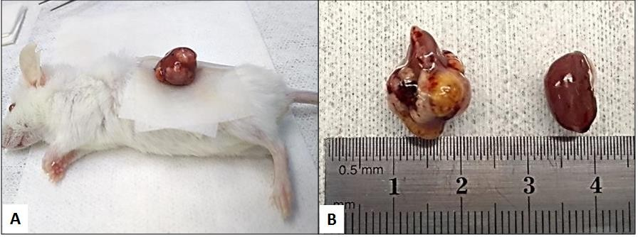
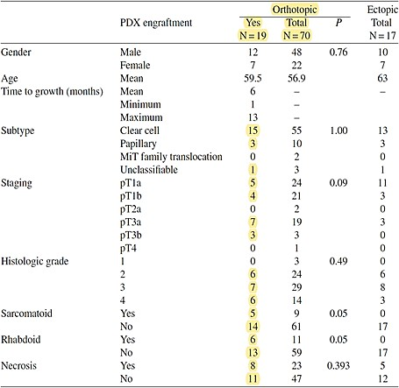
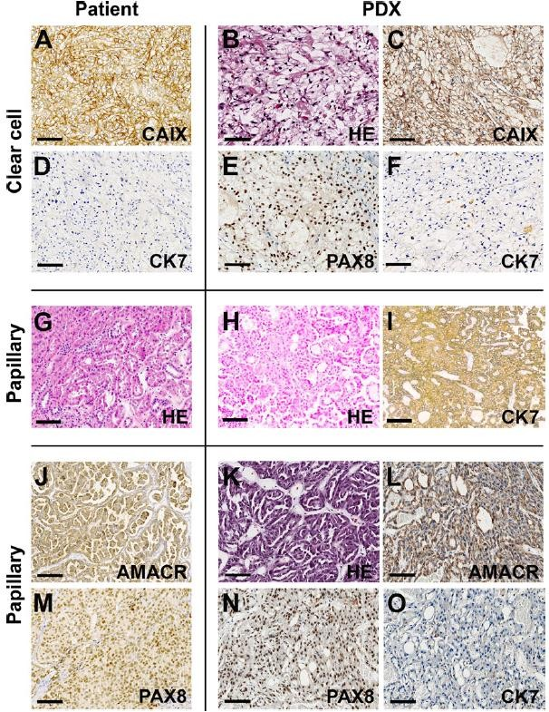
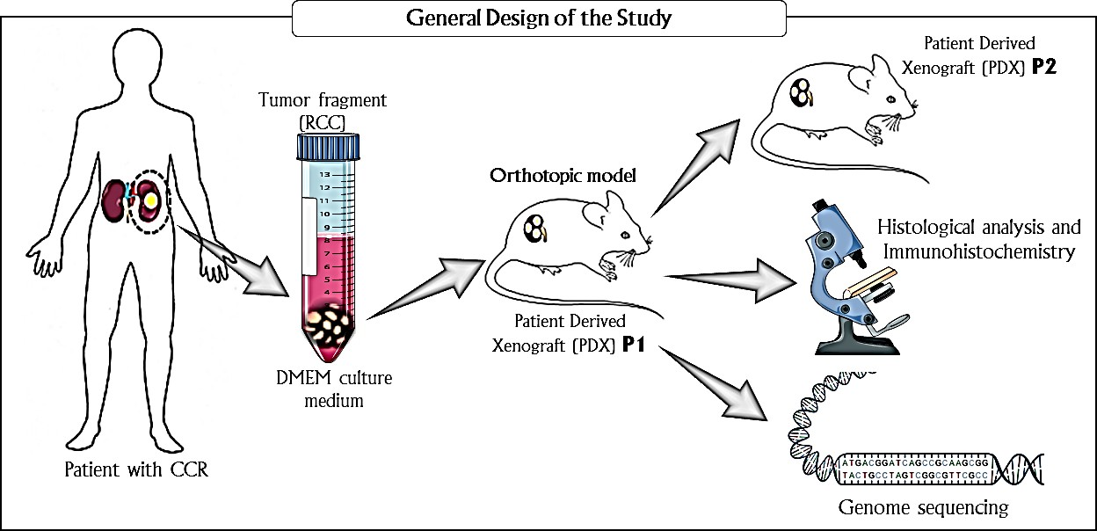
STUDY OF HUMAN KIDNEY CARCINOMA USING THE PATIENT-DERIVED XENOGRAFT MODEL
Beserra, A.O.; Estevam, E.C.; Cunha, I.W.; Bezerra, S.M.; Tanus, I.; Torresan, G.T.; Carraro, D.M.; Zequi, S.C.; M, V.R.; Santos, T.G.
INTRODUCTION AND OBJECTIVE RESULTS
Patient-derived xenografts (PDX) have emerged as one of the most promising model systems to study cancer biology and to develop new antineoplastic drugs. Renal cell carcinoma (RCC) represents up to 90% of all kidney tumors, exhibits aggressive behavior, and has a propensity for metastasis.
At diagnosis, 30% of patients with RCC have metastases, while up to 50% of those with localized disease treated with curative protocols experience recurrence.
Table 1: Clinical characteristics of patients and tumor implantation route influencing PDX take rate.
Table 2: Genetic characterization between primary tumors and PDX tumors.
Histology | Pathological Staging | Gene | Effect of mutation | Frequency in the primary tumor | Frequency in PDX tumor
Clear Cells | pT1b | BAP1 | Missense | 10,0% | 99,0%
 |  | CDKN2A | Missense | 2,9% | 0,0%
 |  | TP53 | Missense | 10,9% | 82,0%
 |  | TP53 | LoF | 6,7% | 4,4%
Papillary | pT3a N1 | ARID1A | LoF | 42,0% | 49,2%
 |  | ARID1A | LoF | 42,8% | 46,0%
Clear Cells | pT3a | VHL | LoF | 28,5% | 79,3%
 |  | PBRM1 | LoF | 31,8% | 98,0%
 |  | KDM5C | LoF | 47,0% | 99,0%
Clear Cells | pT1a | VHL | Missense | 17,3% | 0,0%
 |  | PBRM1 | LoF | 19,9% | 0,0%
Clear Cells | pT1a | VHL | LoF | 46,1% | 86,1%
 |  | PBRM1 | LoF | 50,5% | 88,5%
 |  | AR | Missense | 7,1% | 2,4%
Clear Cells | pT3a | VHL | LoF | 53,3% | 78,1%
 |  | SETD2 | LoF | 54,2% | 71,9%
 |  | PBRM1 | LoF | 50,3% | 69,0%
Clear Cells | pT3b | SETD2 | LoF | 31,1% | 68,1%
 |  | KDM5C | Missense | 26,9% | 57,1%
Papillary | pT1a | MET | Missense | 51,5% | 67,0%
 |  | SMARCA4 | Missense | 37,8% | 51,6%
Clear Cells | pT3a | VHL | LoF | 44,0% | 99,1%
 |  | PBRM1 | LoF | 2,8% | 0,0%
 |  | SETD2 | LoF | 1,7% | 0,0%
 |  | PBRM1 | LoF | 42,0% | 100,0%
Clear Cells | pT3b | TP53 | Missense | 32,8% | 99,7%
Figure 2: Evidence of tumor growth (A) Tumor growth. (B) Comparison between the kidneys
Therefore, the central objective of the present study was to establish a platform of studies based on morphological and genetic characterization of renal tumors in immunodeficient animals.
MATERIALS AND METHODS
CONCLUSION
Taken together, these results suggest that the orthotopic xenograft model of RCC represents a suitable tool to study RCC biology, identify biomarkers, and to test therapeutic candidates.
Figure 1: Standardization of the Orthotopic Implant Model. (A) Left lumbotomy; (B) Isolation of the kidney; (C) Transversal incision in renal capsule; (D) 4 subcapsular tumor fragments.
Figure 3: Morphological characterization. Calibration bars = 100um.

