Slide 1
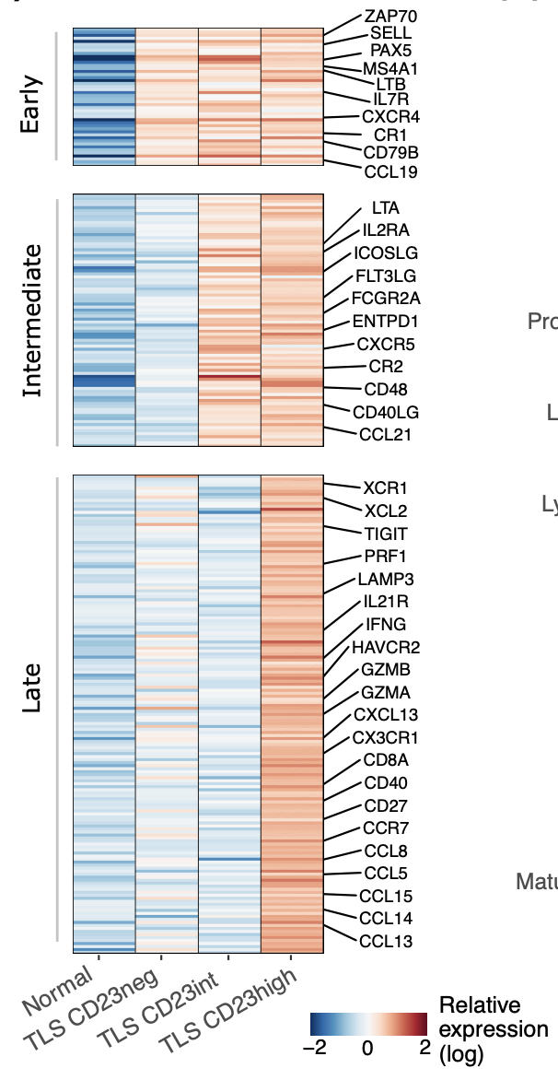
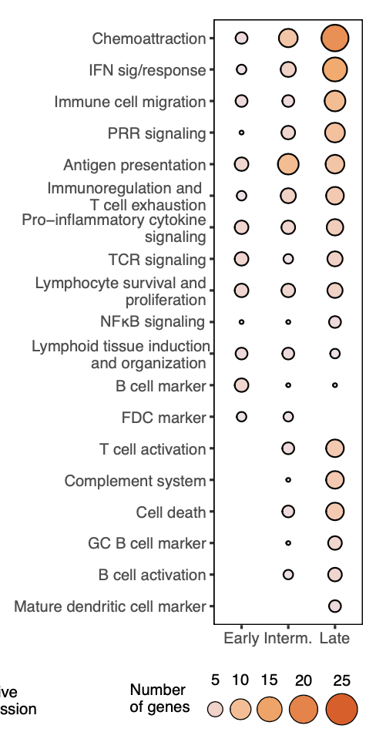
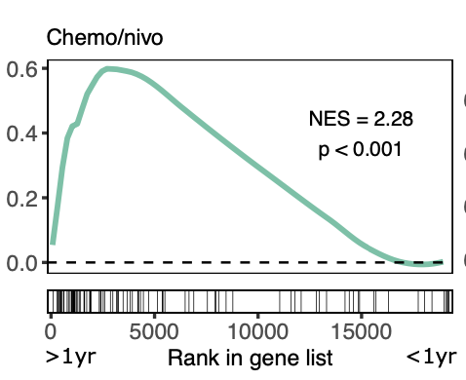
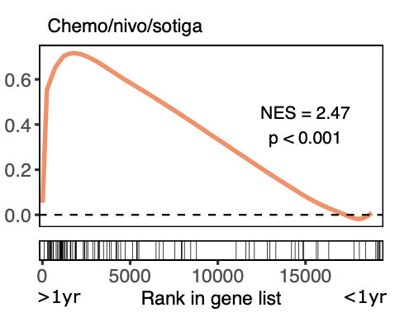
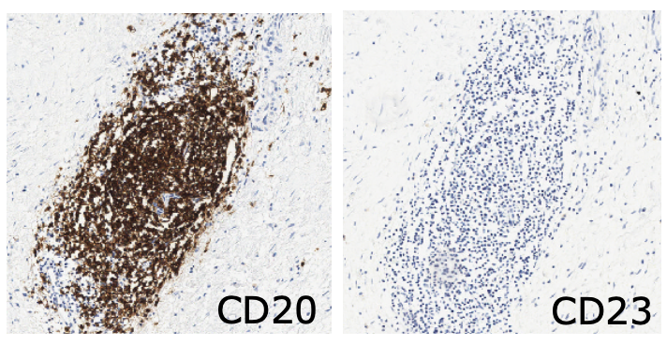
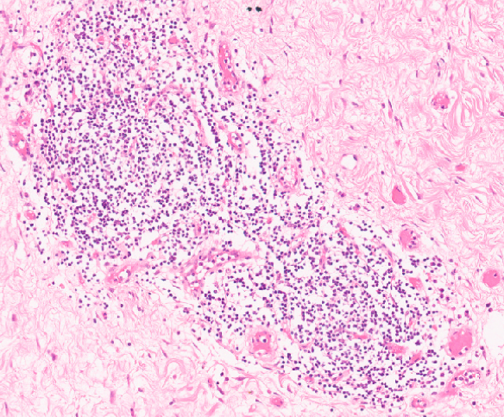
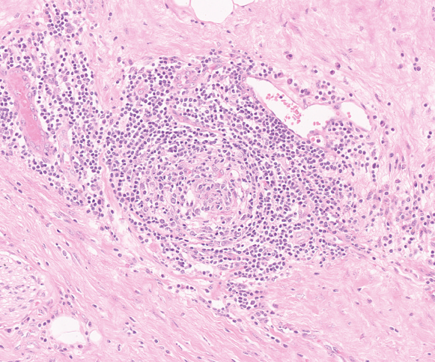
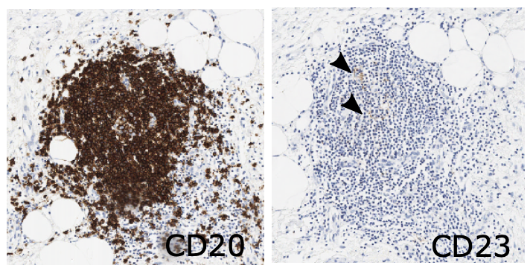
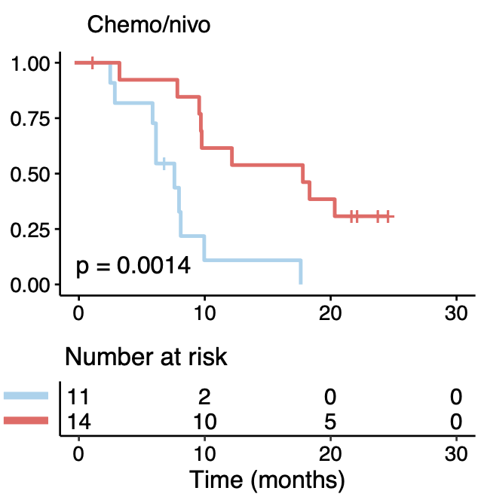
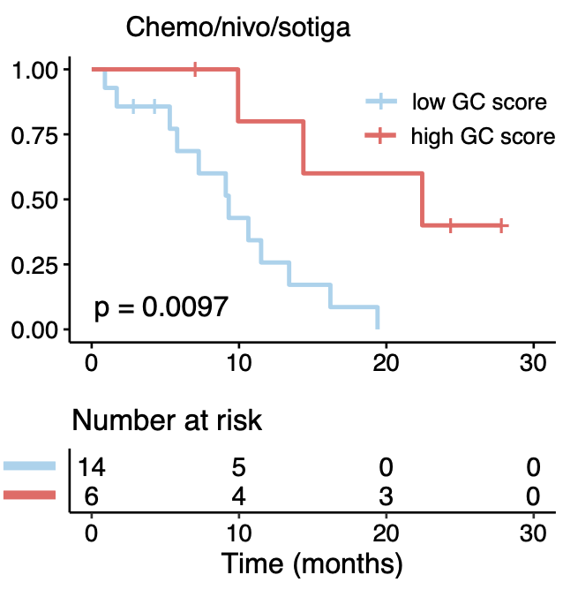
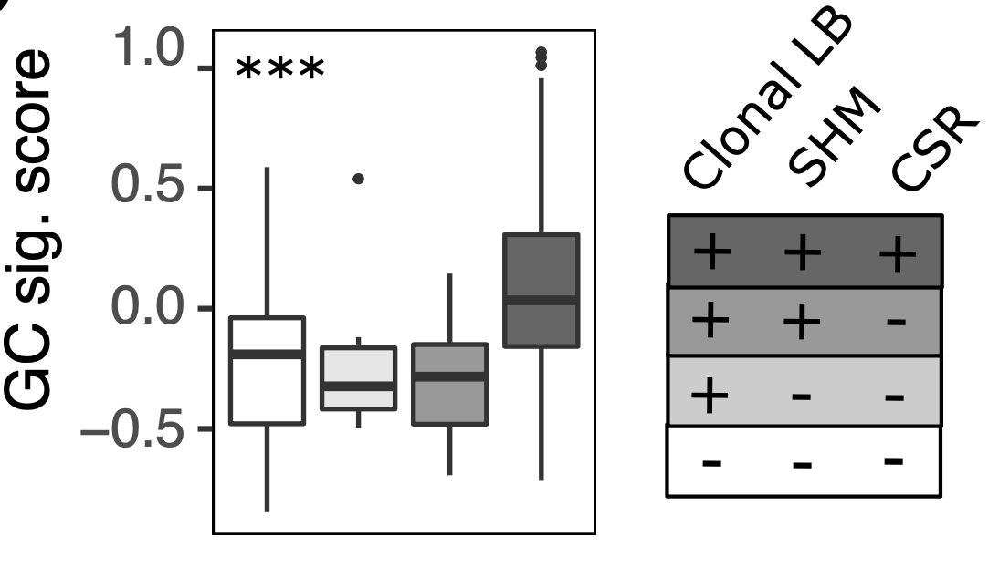
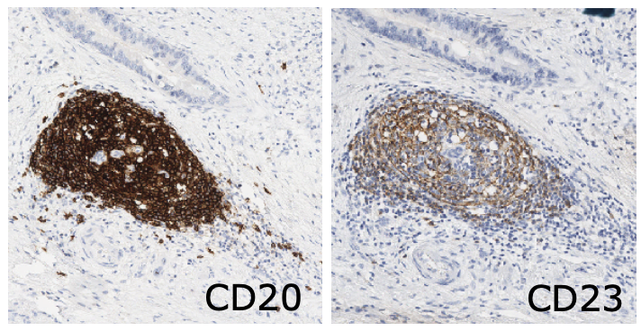
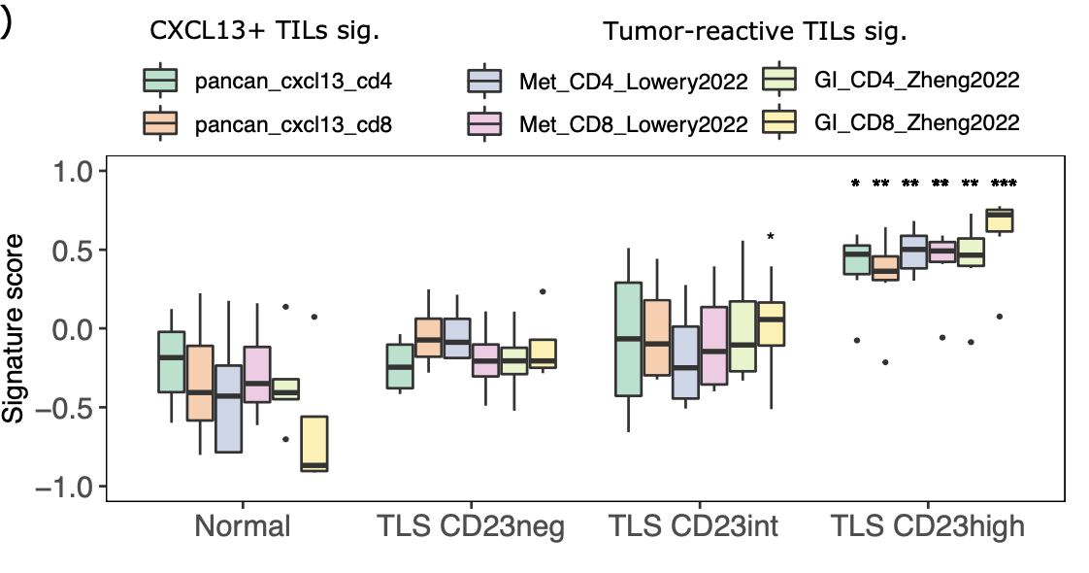
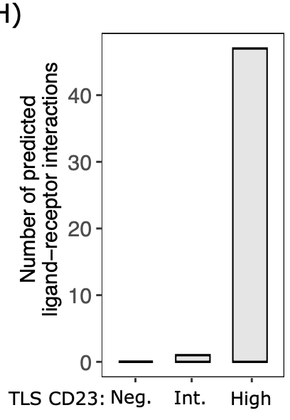
Encontro de Ciência e Inovação 2023
Mature tertiary lymphoid structures are key niches of tumor-specific immune responses in pancreatic ductal adenocarcinomas
Gabriela Sarti Kinker¹, Glauco Akelinghton Freire Vitiello¹, Ariane Barros Diniz², Pedro Henrique Barbosa Pereira¹, Maria Letícia Rodrigues Carvalho¹, Wallax Augusto Silva Ferreira^{1,3}, Alexandre Silva Chaves¹, Amanda Rondinelli¹, Mariela Pires Cabral Piccin¹, Arianne Fagotti Gusmão¹, Alexandre Defelicibus¹, Gabriel Oliveira dos Santos⁴, Warley Abreu Nunes⁴, Laura Carolina López Claro⁵, Talita Magalhães Bernardo⁵, Ricardo Tadashi Nishio⁵, Adhemar Monteiro Pacheco⁵, Ana Carolina Laus⁶, Lidia Maria Rebolho Batista Arantes⁶, Julia L. Fleck⁷, Victor Hugo Fonseca de Jesus⁸, André de Moricz⁵, Ricardo Weinlich², Felipe José Fernandez Coimbra⁹, Vladmir Cláudio Cordeiro de Lima⁸, Tiago da Silva Medina^{1,10}
1. International Research Center, A. C. Camargo Cancer Center, São Paulo, Brazil. 2. Hospital Israelita Albert Einstein, São Paulo, Brazil. 3. Evandro Chagas Institute, Belém, Brazil. 4. Department of Pathology, A. C. Camargo Cancer Center, São Paulo, Brazil. 5. Faculty of Medical Sciences, Santa Casa de Misericórdia do Estado de São Paulo, São Paulo, Brazil. 6. Molecular Oncology Research Center, Barretos Cancer Hospital, Barretos, Brazil. 7. Mines Saint-Etienne, Univ Clermont Auvergne, CNRS, UMR 6158 LIMOS, Centre CIS, Saint-Etienne, France. 8. Department of Medical Oncology, A. C. Camargo Cancer Center, São Paulo, Brazil. 9. Department of Surgical Oncology, A. C. Camargo Cancer Center, São Paulo, Brazil. 10. National Institute of Science and Technology in Oncogenomics and Therapeutic Innovation, São Paulo, Brazil.
Background
Results
Tertiary lymphoid structures (TLSs) are ectopic lymphoid aggregates that develop in non-lymphoid tissues at sites of chronic inflammation, including tumors.
Tumor-associated TLSs may exist under different functional states, according to their structural similarity to secondary lymphoid organs.
Over the past years, checkpoint inhibitor-based immunotherapies have shown remarkable success in a range of tumor types.
Only a subset of pancreatic ductal adenocarcinoma (PDAC) patients may derive durable clinical benefit from available immune checkpoint inhibitors.
(A)
(B)
(C)
(A)
(C)
0.2 mm
Immature TLS: CD23neg
Immature
TLS without GC
0.2 mm
Mature TLS without GC: CD23int
Mature
TLS with GC
(D)
(B)
Aim
Fully mature TLS with GC: CD23hi
As mature tumor-associated TLSs may represent sheltered niches for optimal lymphocyte activity, we investigated the impact of TLS maturation on the generation of tumor-specific immunity and patient response to chemoimmunotherapy.
B cell differentiation
Figure 2. Clinical relevance of mature TLSs in PDACs. (A) Representative images of H&E-stained sections from TCGA PDACs with immature (up) and mature (down) TLSs. Tumors with mature TLSs were used to derive a GC-specific signature using RNA-seq data. The circle indicates a GC. (B) GC signature score in TCGA PDACs with different degrees of B cell differentiation, as defined by the occurrence of somatic hypermutation and class switch recombination in IgH sequences. (C) Gene set enrichment analysis of the GC signature comparing PDAC RNA-seq data from patients that survived >1yr vs. <1yr after receiving different chemoimmunotherapy regimens (PRINCE trial cohort). (D) Kaplan-Meier survival curves and log-rank test comparing PRINCE trial patients with high vs. low GC signature scores. *** p < 0.001 (one-way ANOVA).
Methods
(D)
(E)
Number of predicted ligand-receptor interaction
Evaluate the expression of 730 immune-related genes in TLSs at different maturation stages, from treatment-naïve primary PDACs (CEP 2712/19), using microdissection and the Nanostring nCounter platform.
Analysis of paired H&E-stained slides and RNA-seq data from 148 treatment-naïve primary PDACs in the The Cancer Genome Atlas (TCGA).
Analysis of RNA-seq data from 105 pre-treatment biopsies of first-line metastatic PDAC patients that received chemoimmunotherapy (PRINCE trial).
TLS
CD23:
0
10
20
30
40
Neg.
Int.
Conclusions
High
Figure 1. Gene expression profile of PDAC-associated TLSs at different maturation stages. (A) Representative immunohistochemistry of PDAC-associated TLSs stained for CD20 and CD23. Prior to the microdissection, TLSs were classified according to the presence of CD23⁺ mature follicular dendritic cells within germinal centers (GCs). (B) Heatmap shows the average relative expression of genes with distinct expression patterns throughout the maturation process, identified using K-means clustering. (C) Functional annotation of genes in each module. (D) Expression of gene signatures derived from neo-antigen reactive T cells by normal pancreatic tissue and CD23neg/int/high TLSs. (E) Number of inferred ligand-receptor interactions in CD23neg/int/high TLSs. *p < 0.05, **p < 0.01, ***p < 0.001 (one-way ANOVA).
PDAC-associated TLSs can develop into fully mature structures where B cells differentiate into plasma cells, culminating with the production of disease-relevant antibodies.
Mature TLSs support T cell activity and are enriched with tumor-reactive T cells, indicating that antitumor adaptive immunity can be generated/boosted directly at the tumor.
The presence of tumor-associated mature TLSs may guide
the selection of PDAC patients for future immunotherapy trials.
Financial support:

